Slide 1



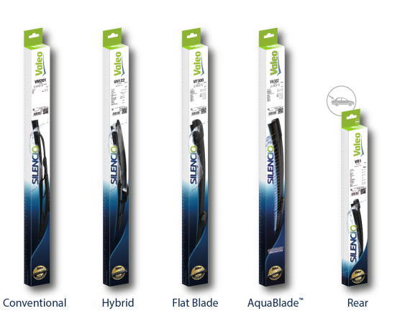
SAFE
DRIVING
Providing the cleanest windscreen with Valeo wipers allows you to drive safer

Slide 2



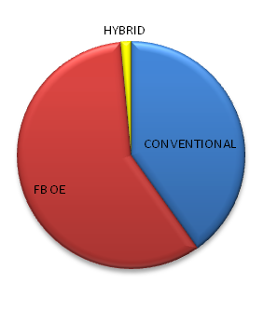
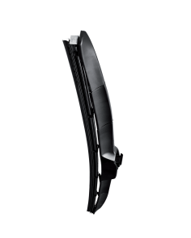

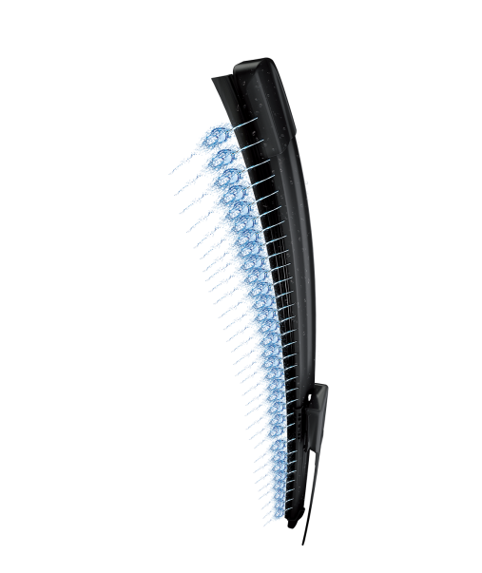
More than 98%
coverage of European parc
295 P/N
already available
+17 P/N
By end of Q1 2019
Valeo is the only supplier offering
all Wiper O.E. Technologies including:
Share of Valeo Silencio sales per wiper technology
HYBRID
Notes:
Why is Valeo a legitimate player for the aftermarket solution in this range?
Legitimacy via technology or beacause leader or because OE adquisitions
Market share OE or growth OE
Innovation OE/IAM
Quality references (awards)
Integration in Valeo Group strategy (smart, green solutions...)
Product regognition IAM or OE

Slide 3
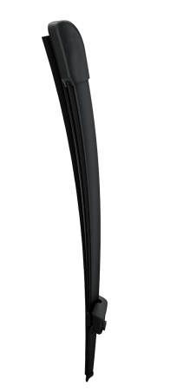

LEGITIMATE POSITIONING
The offer of the n°1 Wipers System original equipment manufacturer

Slide 4





has accompanied you with success for more than
20 years
More than
130 Million
wiper blades produced by Valeo every year
1 out of 2 vehicles are equipped with Valeo wiper blades
EXCLUSIVITY
Notes:
Why is Valeo a legitimate player for the aftermarket solution in this range?
Legitimacy via technology or beacause leader or because OE adquisitions
Market share OE or growth OE
Innovation OE/IAM
Quality references (awards)
Integration in Valeo Group strategy (smart, green solutions...)
Product regognition IAM or OE

Slide 5
WHY CHOOSE VALEO?
Make your workshop life easier with

Slide 6



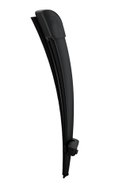




Silencio Flat Blades are 100%
T.U.V. certified
Best performance over time ensuring customer satisfaction
Valeo category management means business development!
95%
of the range Made in France
Perfect fit in one click with the Original Technology
Notes:
Why is Valeo a legitimate player for the aftermarket solution in this range?
Legitimacy via technology or beacause leader or because OE adquisitions
Market share OE or growth OE
Innovation OE/IAM
Quality references (awards)
Integration in Valeo Group strategy (smart, green solutions...)
Product regognition IAM or OE

Slide 7
GROWTH OPPORTUNITIES
Develop your business in the most simple way: with Valeo Service

Slide 8

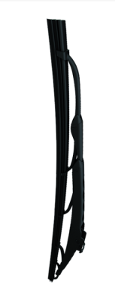
THE ESSENTIALS
CHOOSE THE RIGHT CARDS
THE ESSENTIALS
CHOOSE THE RIGHT CARDS
FLAT BLADES
CONVENTIONAL
Valeo Ref | Short Code | Length (mm) | Type of Blades
574363 | VF322 | 600 + 400 | SILENCIO FBOE PSA C3 PICASSO RLT CLIO III
574385 | VF330 | 600 + 475 | SILENCIO FBOE VW JETTA / GOLF
574324 | VF411 | 650 + 425 | SILENCIO FBOE FORD FOCUS II PEUGEOT 207
574668 | VF468 | 650 + 400 | SILENCIO FBOE PSA BERLINGO PARTNER
574645 | VF445 | 600 + 400 | SILENCIO FBOE RLT TWINGO II SEAT IBIZA IV
574474 | VF374 | 600 + 380 | SILENCIO FBOE AUDI A1 VW POLO
574680 | VF480 | 750 + 650 | SILENCIO FBOE PSA C4 308
574641 | VF441 | 600 + 450 | SILENCIO FBOE VW PASSAT CC
574392 | VF429 | 650 + 550 | SILENCIO FBOE PSA JUMPER BOXER
574346 | VF310 | 600 + 475 | SILENCIO FBOE AUDI A3 VW GOLF
574703 | VF383 | 650 + 350 | SILENCIO FBOE RENAULT CLIO 4
574394 | VF334 | 600 + 350 | SILENCIO FBOE FIAT 500 500C FORD KA
574707 | VF387 | 650 + 450 | SILENCIO FBOE AUDI A3 /VW GOLF
574462 | VF362 | 600 + 500 | SILENCIO FBOE AUDI A4/A5/Q3/Q5
574678 | VF478 | 750 + 650 | SILENCIO FBOE RENAULT SCENIC 3
574688 | VF488 | 800 + 700 | SILENCIO FBOE PEUGEOT 3008/5008
574673 | VF473 | 650 + 650 | SILENCIO FBOE OPEL ASTRA J PEUGEOT 508
574303 | VF302 | 550 + 550 | SILENCIO FBOE AUDI A4 / A6
574470 | VF370 | 600 + 475 | SILENCIO FBOE BMW 3-SERIES
574375 | VF426 | 650 + 400 | SILENCIO FBOE OPEL CORSA
Valeo Ref | Short Code | Length (mm) | Type of Blades
574112 | V45 | 450 | SILENCIO WIPER STANDARD
574118 | V55 | 550 | SILENCIO WIPER STANDARD
574116 | V51 | 510 | SILENCIO WIPER STANDARD
574110 | V41 | 400 | SILENCIO WIPER STANDARD
574107 | V35 | 350 | SILENCIO WIPER STANDARD
574145 | VM20 | 650 | SILENCIO WIPER PERFORMANCE
574117 | V53 | 530 | SILENCIO WIPER STANDARD
574114 | V48 | 480 | SILENCIO WIPER STANDARD
574140 | VM15 | 600 | SILENCIO WIPER PERFORMANCE
574158 | VM108 | 600 | SILENCIO WIPER PERFORMANCE
574141 | VM16 | 600 | SILENCIO WIPER PERFORMANCE
574147 | VM22 | 410 | SILENCIO WIPER PERFORMANCE
574132 | VM7 | 500 | SILENCIO WIPER PERFORMANCE
574250 | VM111 | 650 | SILENCIO WIPER PERFORMANCE
574136 | VM11 | 550 | SILENCIO WIPER PERFORMANCE
574106 | V28 | 280 | SILENCIO WIPER STANDARD
574108 | V38 | 380 | SILENCIO WIPER STANDARD
574119 | V58 | 575 | SILENCIO WIPER STANDARD
574129 | VM4 | 450 | SILENCIO WIPER PERFORMANCE
574157 | VM107 | 550 | SILENCIO WIPER PERFORMANCE

Slide 9
THE ESSENTIALS
CHOOSE THE RIGHT CARDS
THE ESSENTIALS
CHOOSE THE RIGHT CARDS
REAR
NEW TO RANGE
Valeo Ref | Short Code | Length (mm) | Type of Blades
574164 | VR27 | 350 | SILENCIO WIPER REAR
574151 | VR26 | 300 | SILENCIO WIPER REAR
574128 | VR3 | 400 | SILENCIO WIPER REAR
574247 | VR30 | 290 | SILENCIO WIPER REAR
574299 | VR260 | 280 | SILENCIO WIPER REAR
574202 | VR59 | 300 | SILENCIO WIPER REAR
574300 | VR250 | 335 | SILENCIO WIPER REAR
574205 | VR38 | 300 | SILENCIO WIPER REAR
574126 | VR1 | 300 | SILENCIO WIPER REAR
574197 | VR49 | 350 | SILENCIO WIPER REAR
Valeo Ref | Short Code | Length (mm) | Type of Blades
577938 | VM938 | 550 + 400 | SILENCIO FB OE DACIA DOKKER LODGY
577940 | VM940 | 600 + 450 | SILENCIO FB OE DACIA DUSTER I
577932 | VM932 | 600 + 500 | SILENCIO FB OE LAND ROVER DISCOVERY
577932 | VM932 | 600 + 500 | SILENCIO FB OE LAND ROVER RANGE ROVER
577934 | VM934 | 650 + 400 | SILENCIO FB OE LEXUS NX300H
577944 | VM944 | 580 + 530 | SILENCIO FB OE MINI COUNTRYMAN
577930 | VM930 | 680 + 425 | SILENCIO FB OE PEUGEOT 3008 II
577930 | VM930 | 680 + 425 | SILENCIO FB OE PEUGEOT 5008 II
577942 | VM942 | 650 + 380 | SILENCIO FB OE RENAULT CAPTUR
577934 | VM934 | 650 + 400 | SILENCIO FB OE TOYOTA C-HR
577936 | VM936 | 700 + 400 | SILENCIO FB OE TOYOTA PRIUS
577950 | VF950 | 655 + 505 | SILENCIO FB OE BMW X3 X4
577952 | VF952 | 700 + 345 | SILENCIO FB OE FIESTA VII
577946 | VF946 | 580 + 350 | SILENCIO FB OE NISSAN JUKE
572304 | VA304 | 580 + 450 | SILENCIO AQUABLADE RENAULT ALPINE
577948 | VF948 | 625 + 530 | SILENCIO FB OE SKODA KODIAQ
577954 | VF954 | 705 + 655 | SILENCIO FB OE VW CRAFTER
572302 | VA302 | 650 + 480 | SILENCIO AQUABLADE XC60 NO HEATING OPTION
572308 | VA308 | 650 + 480 | SILENCIO AQUABLADE XC60 HEATING OPTION
572310 | VA310 | 600 + 500 | SILENCIO AQUABLADE V60 NO HEATING OPTION
572312 | VA312 | 600 + 500 | SILENCIO AQUABLADE V60 HEATING OPTION
HYBRID
Valeo Ref | Short Code | Length (mm) | Type of Blades
574736 | VH136 | 700 | SILENCIO WIPER HYBRID
574734 | VH134 | 650 | SILENCIO WIPER HYBRID
574724 | VH124 | 400 | SILENCIO WIPER HYBRID
574732 | VH132 | 600 | SILENCIO WIPER HYBRID
574726 | VH126 | 450 | SILENCIO WIPER HYBRID
574722 | VH122 | 350 | SILENCIO WIPER HYBRID
574729 | VH129 | 525 | SILENCIO WIPER HYBRID
574728 | VH128 | 500 | SILENCIO WIPER HYBRID
574727 | VH127 | 480 | SILENCIO WIPER HYBRID
574730 | VH130 | 550 | SILENCIO WIPER HYBRID

