Slide 1
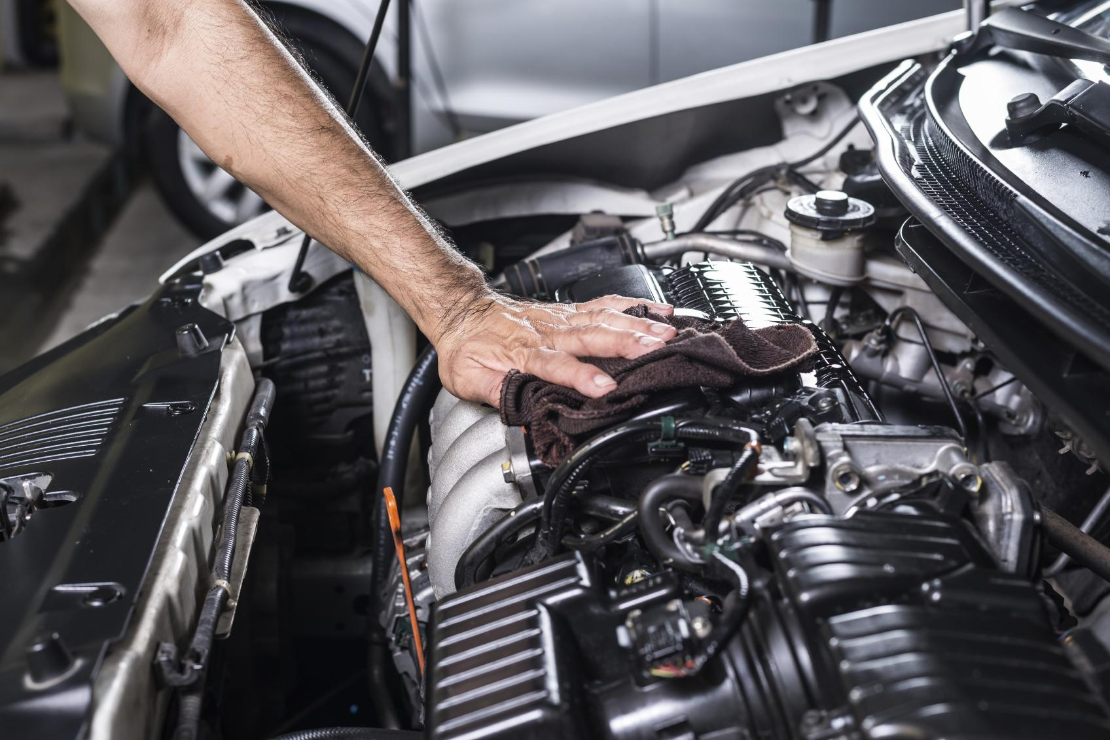

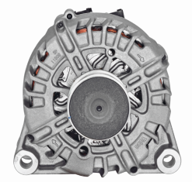
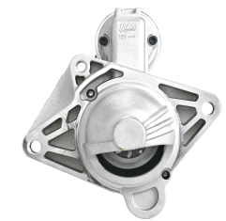
SMART
SOLUTIONS
NEW STARTERS
& ALTERNATORS
Smart core-free solutions to make
Distributors’ and workshops’ life easier

Slide 2
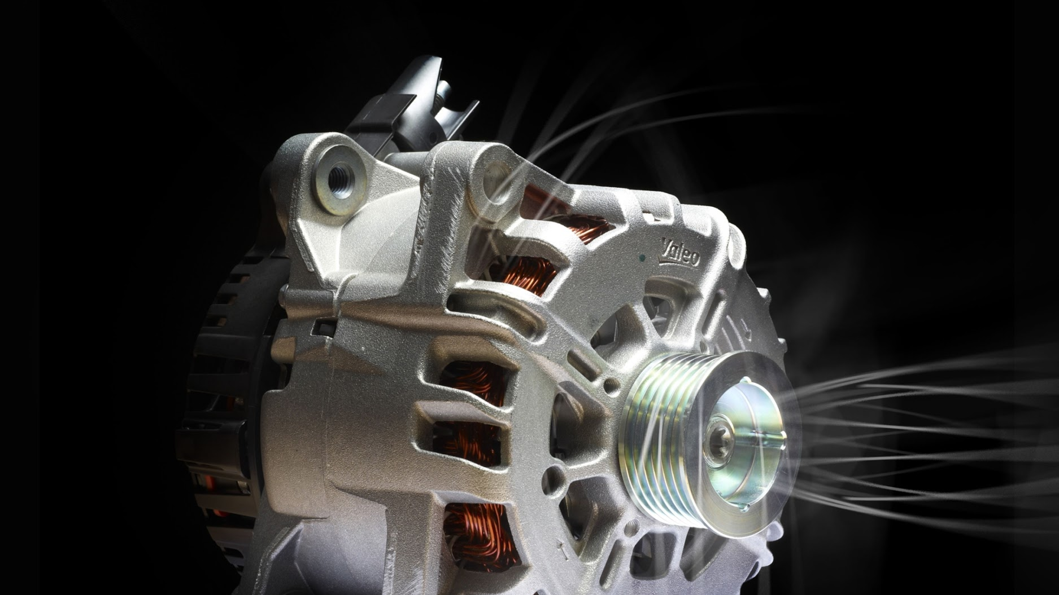

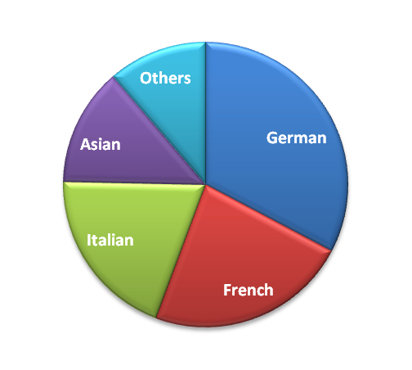
53%
coverage of European parc
+14pts by Q1 2019
ROTATING
1 300 P/N
already available
+200 P/N*
Available before end of Q1 2019
+60%
sales growth in 2018
Share of Valeo sales per car manufacturer origin
Notes:
Why is Valeo a legitimate player for the aftermarket solution in this range?
Legitimacy via technology or beacause leader or because OE adquisitions
Market share OE or growth OE
Innovation OE/IAM
Quality references (awards)
Integration in Valeo Group strategy (smart, green solutions...)
Product regognition IAM or OE

Slide 3
STARTERS & ALTERNATORS
LEGITIMATE POSITIONING
Worldwide leader and innovator
in Electrical Systems

Slide 4
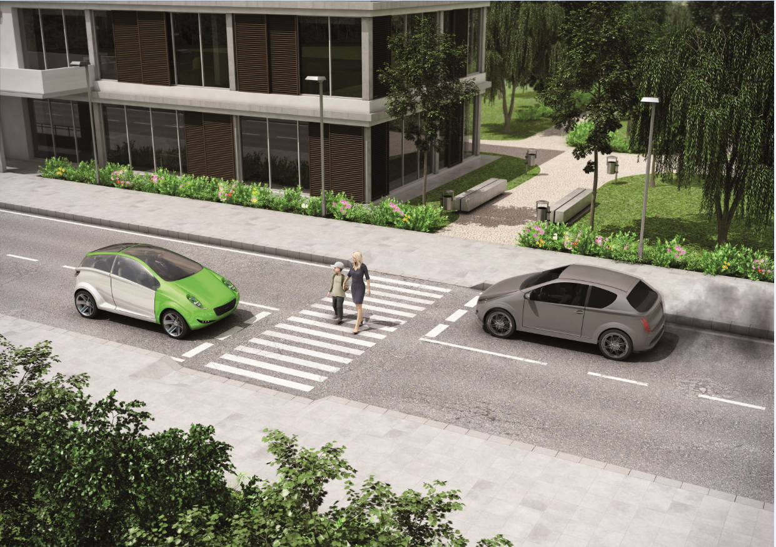



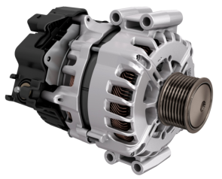
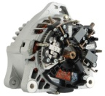
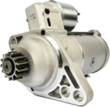

RECOGNIZED EXPERT in Electrical Systems
Since 1923
ROTATING
INNOVATION
Unique O.E. supplier of both Stop&Start technologies
(iStARS and Restarter)
Valeo produces 200 000
Starters & Alternators
every day
O.E. partner of all major car manufacturers
#1 Worldwide
Leader in
48 Volts electrification
Notes:
Why is Valeo a legitimate player for the aftermarket solution in this range?
Legitimacy via technology or beacause leader or because OE adquisitions
Market share OE or growth OE
Innovation OE/IAM
Quality references (awards)
Integration in Valeo Group strategy (smart, green solutions...)
Product regognition IAM or OE

Slide 5
STARTERS & ALTERNATORS
WHY CHOOSE VALEO?
The perfect range to address the newest technologies on the market

Slide 6
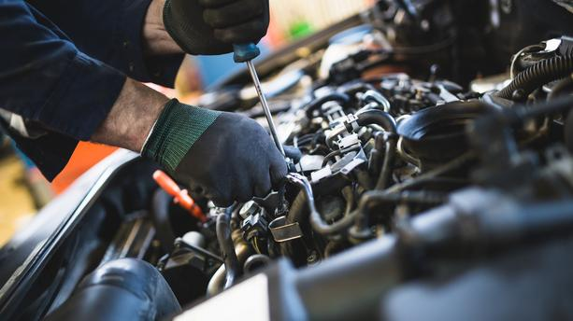

Simple
Competitive ”surcharge free” offer
ROTATING
Large offer addressing
fast moving vehicles
and
newest technologies
Best-in-Class Quality
100%
O.E. specifications
Tech’Care
Experts and Advanced Hotline
Notes:
Why is Valeo a legitimate player for the aftermarket solution in this range?
Legitimacy via technology or beacause leader or because OE adquisitions
Market share OE or growth OE
Innovation OE/IAM
Quality references (awards)
Integration in Valeo Group strategy (smart, green solutions...)
Product regognition IAM or OE

Slide 7
STARTERS & ALTERNATORS
GROWTH OPPORTUNITIES
Develop your business in the most simple way: with Valeo Service

Slide 8


z
THE ESSENTIALS
CHOOSE THE RIGHT CARDS
STOP&START CARDS
MAKE A DIFFERENCE WITH VALEO
VALEO REF | MAIN APPLICATIONS |  | TECH. CODE
439292 | NISSAN, OPEL, RENAULT | NISSAN Interstar, Primastar OPEL Movano, Vivaro RENAULT Laguna, Master, Trafic | SG12B017
439441 | VAG | AUDI A3, A4 SKODA Fabia, Octavia VOLKSWAGEN Bora, Golf,Passat, Polo | SG9B078
439505 | FIAT | FIAT 500, Doblo, Idea, Panda, Punto, Tipo | TG9S010
439545 | BMW | BMW 1 series, 3 series, 5 series, 7 series | TG15C093
439546 | MERCEDES | MERCEDES A/C/E Class, Sprinter, Vito | TG17C030B
439552 | MERCEDES | MERCEDES A/B/C Class | TG15C121
439619 | MERCEDES | MERCEDES Sprinter, Viano, Vito | TG17C061
439653 | MERCEDES | MERCEDES A/C/E Class, Sprinter, Viano, Vito | FG18S012
439664 | VAG | AUDI A1 VOLKSWAGEN Golf, Passat, Polo, Tiguan, Touran | TG14C026
439674 | PSA | CITROEN C3, C4, C5, C8, Jumper, Jumpy PEUGEOT 206, 207, 307, 308, 407, 3008, 5008 | TG15C134
i-StARS
Valeo is the pionnier and the leader of stop & start solutions
Plug & Play technology
VALEO REF | MAIN APPLICATIONS |  | TECH. CODE
439864 | PSA | CITROEN C4 Picasso PEUGEOT 3008, 308, 5008 | IST60C030
439866 | SUBARU | SUBARU Forester, XV | IST60C021
439869 | NISSAN | NISSAN X-Trail | IST50C012
439902 | MERCEDES | MERCEDES: B Class | ST35C015
439965 | PSA | CITROEN Berlingo, C4 Cactus, C4 Picasso PEUGEOT 3008, 308, 5008, Partner | IST60C032
439981 | AUDI | AUDI Q7 | IST60C027

Slide 9
z
THE ESSENTIALS
CHOOSE THE RIGHT CARDS
STOP&START CARDS
MAKE A DIFFERENCE WITH VALEO
VALEO REF | MAIN APPLICATIONS |  | TECH. CODE
432644 | MERCEDES | MERCEDES C/E/G/S/V Class, Sprinter, Vito | D9R149
432685 | RENAULT | DACIA Logan, Sandero RENAULT Clio, Kangoo, Modus, Thalia, Twingo, Wind | TS8E6(a)
438068 | PSA | CITROEN C Crosser, C4, C5, C8 PEUGEOT 307, 407, 607, 807, 4007, Boxer, Partner | D7R26
438133 | PSA | CITROEN C3, C4, C5, DS3, DS4, Space Tourer PEUGEOT 208, 301, 308, 407, 2008 | TS14E110
438168 | FIAT | ALFA ROMEO Mi.To FIAT 500, Aegea, Albea, Panda, Punto, Qubo, Strada, Tipo LANCIA Musa, Ypsilon | D6G321
438175 | VAG | AUDI A3, TT VOLKSWAGEN Golf, Jetta, Passat, Polo, Touran | D7GS8
438183 | OPEL | OPEL Agila, Astra, Corsa, Meriva, Omega, Signum, Tigra, Vectra, Zafira | D6RA93
438224 | RENAULT | DACIA Dokker, Duster, Lodgy, Logan, Sandero RENAULT Captur, Clio, Kadjar, Laguna, Mégane, Scenic | TS12E9B
438285 | LADA | LADA 110, Kalina, Priora | TS12E901
438328 | DACIA | DACIA Logan | TS12-80
ReStart
  Easy fitting in the engine environment.
  Designed with reinforced components for 10 times more lifetime compared to a conventional starter
VALEO REF | MAIN APPLICATIONS |  | TECH. CODE
438279 | RENAULT | RENAULT Captur, Kangoo, Mégane, Twingo | ESW10-12
438326 | BMW | BMW 3 series, 5 series, 7 series | RSM18HA-10
438339 | VAG | AUDI A3, Q3, TT VOLKSWAGEN Arteon, Golf, Passat, Polo, Touran | RSW20R-10
438342 | VAG | VOLKSWAGEN Amarok | RSW22R-15
438343 | BMW | BMW 5 series, 7 series, X3 | RSW22A-11
438357 | RENAULT | DACIA Duster RENAULT Captur, Clio, Mégane, Scenic, Twingo | ESW10-14

