Slide 1
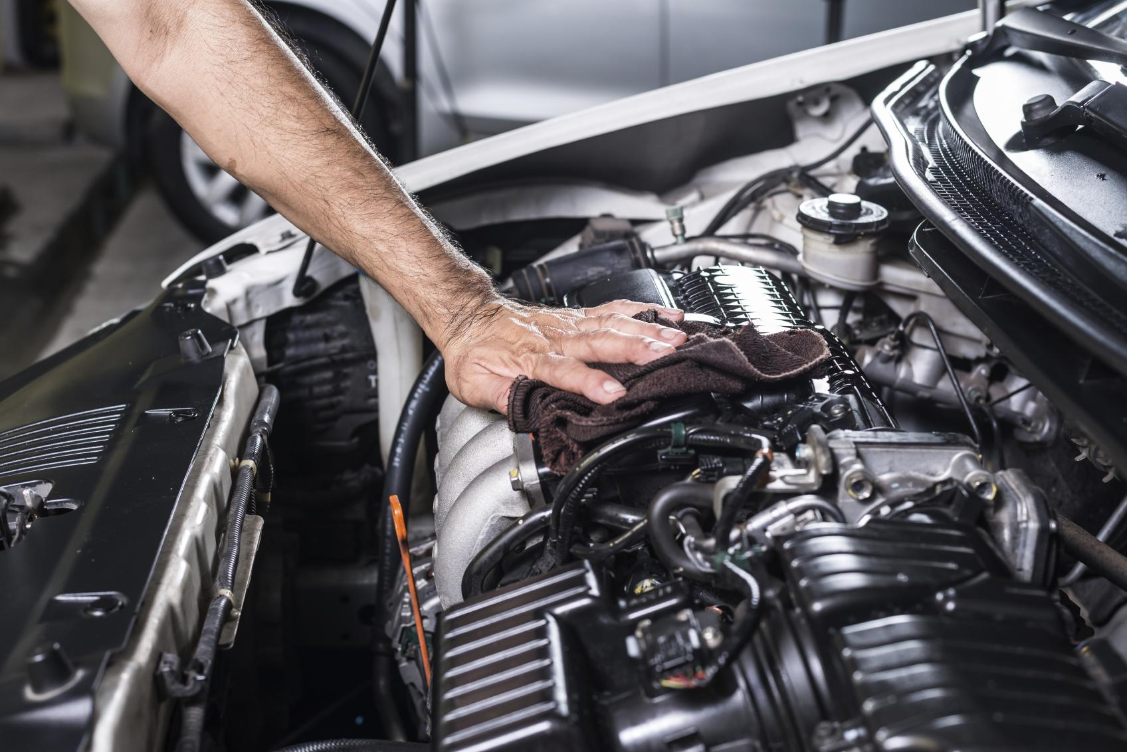

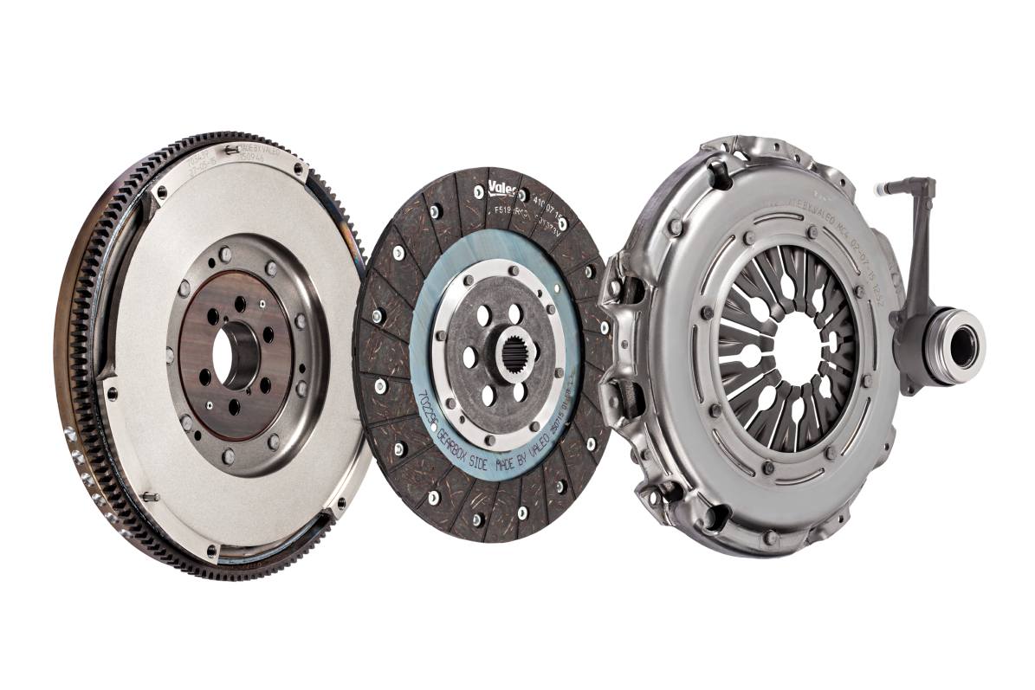

SMART
SOLUTIONS
FullPACK
DMFTM
Make your workshop life easier
with all-in-1 clutch solutions

Slide 2
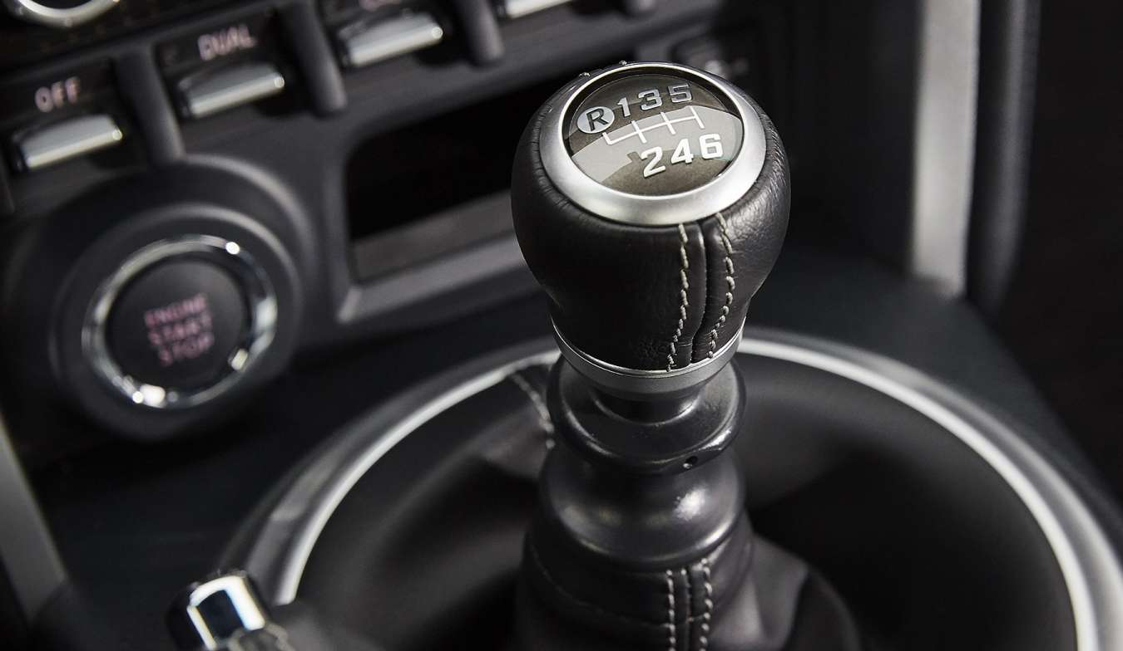
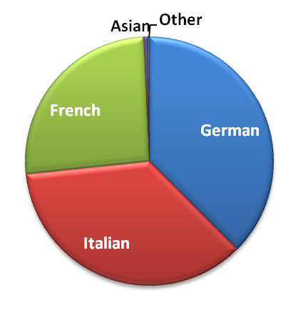
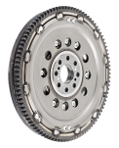
71%*
coverage of European parc
* DMF and Valeo FullPACKDMFTM
FullPACK DMFTM
124
FullPACK DMFTM
+49 P/N to come
by Q1 2019
216
Dual Mass Flywheels
++26 P/N to come
by Q1 2019
+70%
sales growth in 2018 on Valeo FullPackDMFTM
Share of Valeo FullPackDMFTM
sales per car manufacturer origin
Notes:
Why is Valeo a legitimate player for the aftermarket solution in this range?
Legitimacy via technology or beacause leader or because OE adquisitions
Market share OE or growth OE
Innovation OE/IAM
Quality references (awards)
Integration in Valeo Group strategy (smart, green solutions...)
Product regognition IAM or OE

Slide 3
DMF RANGE
LEGITIMATE POSITIONING
95 years O.E. expertise dedicated
to clutch systems

Slide 4
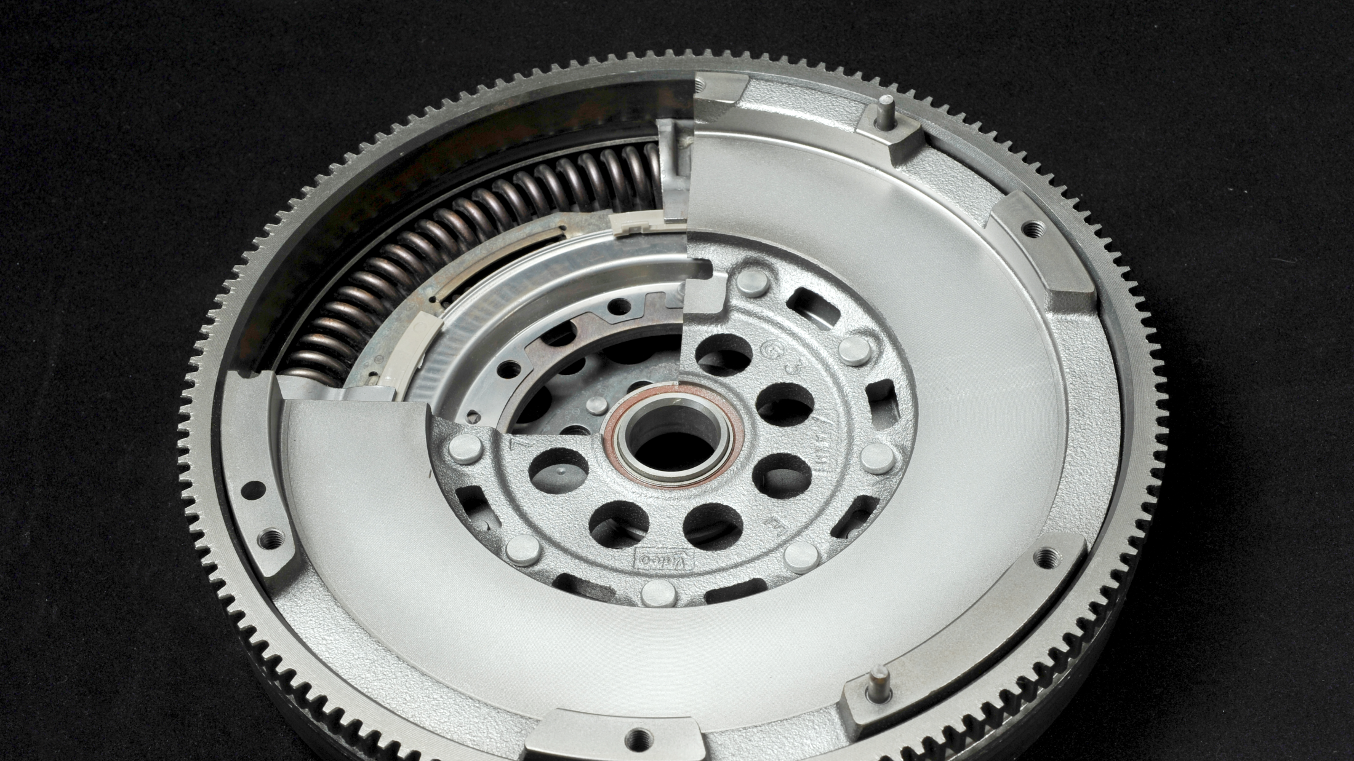




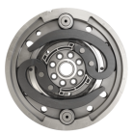


Valeo produces DMF in its O.E. plants in Italy, Spain, Turkey, Korea and China
FullPACK DMFTM
RECOGNIZED EXPERT
in clutch systems
Since 1923
O.E. DMF manufacturer
for German, French, Italian, Asian and American car applications
DMF innovator
Valeo
VBladeTM DMF
More than 80 patents
Notes:
Why is Valeo a legitimate player for the aftermarket solution in this range?
Legitimacy via technology or beacause leader or because OE adquisitions
Market share OE or growth OE
Innovation OE/IAM
Quality references (awards)
Integration in Valeo Group strategy (smart, green solutions...)
Product regognition IAM or OE

Slide 5
DMF RANGE
WHY CHOOSE VALEO?
The innovation of an O.E. Leader
at the service of the aftermarket

Slide 6
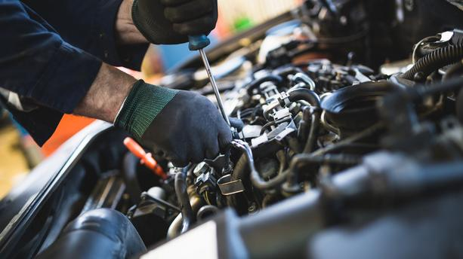

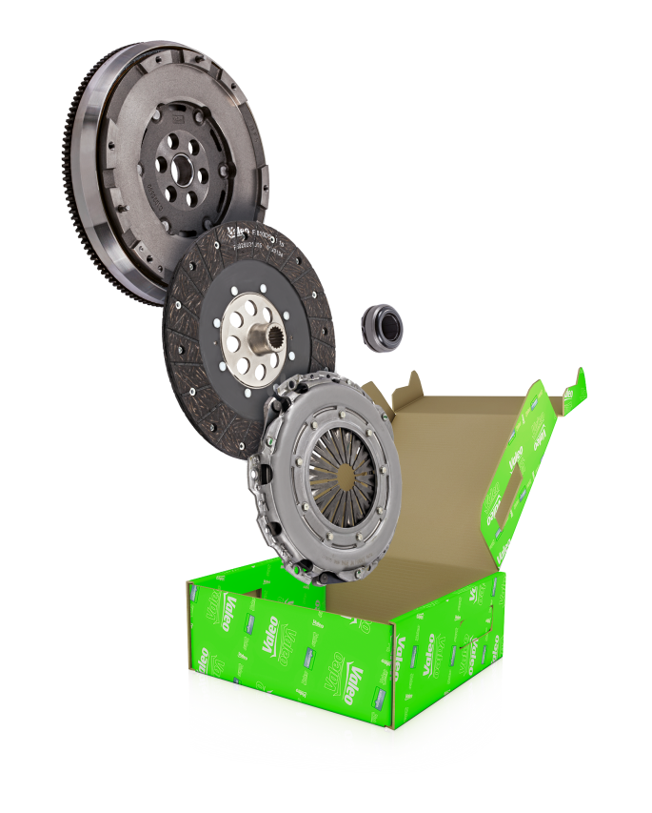
COMPETITIVE
More competitive than individual components
FullPACK DMFTM
GROWING MARKET
115
MILLION
vehicles equipped with DMF in Europe
QUALITY ENGAGEMENT
O.E. specifications for all components certified by Valeo
ALL-IN-ONE
Quicker choice
Easier to order
No mismatch of components
Easier to fit (bolts included)
Notes:
Why is Valeo a legitimate player for the aftermarket solution in this range?
Legitimacy via technology or beacause leader or because OE adquisitions
Market share OE or growth OE
Innovation OE/IAM
Quality references (awards)
Integration in Valeo Group strategy (smart, green solutions...)
Product regognition IAM or OE

Slide 7
DMF RANGE OFFER
GROWTH OPPORTUNITIES
Develop your business in the most simple way: with Valeo Service

Slide 8


z
THE ESSENTIALS
CHOOSE THE RIGHT CARDS
NEW CARDS
MAKE A DIFFERENCE WITH VALEO
VALEO REF | MAIN APPLICATIONS |  | IAM CROSS
837073 | VW | Golf V 1.9 TDI | 600001600
837038 | ALFA ROMEO | 147 1.9 JTDM, 156 1.9 JTD | 623354600
837397 | VW | Golf VI 2.0 TDI | 600001700
837322 | PSA | C4, C5, DS4, 3008, 508 1.6Hdi | 600014300
837409 | VW | Sharan 1.9 TDI | 600017200
837321 | VW | Transporter V 2,5 TDI (03>09) | 600012500
837305 | FORD | C-Max, Focus II 1.6 TDCi | 600020000
837304 | VAG | A3, Leon, Golf IV 1.9 TDI | 600001300
837302 | OPEL | Astra H, Corsa D 1.7 CDTI | 624343333
837086 | BMW | 5 series 320d | 600023800
837060 | VAG | A4, Exeo, Superb I | 600022800
837005 | FIAT | Bravo (2007>), Stilo (2004>) | 600005800
837018 | VW | Transporter T5 Box ,1.9 TDI | 600016900
837041 | VW | Passat Variant (3B6) 1.9 TDI | 600004000
837003 | VW | Passat Variant (3B5) 1.9 TDI | 600002900
VALEO REF | MAIN APPLICATIONS |  | IAM CROSS
837017 | VW | Golf IV 1.9 TDI | 600000600
837075 | VW | Golf VI 1.6TDI | 600019900
837074 | VW | Golf VI 1.6TDI | 600019800
837427 | RENAULT | Master III | 600023500
837424 | NISSAN | Qashqai 2.0 dCi | 600020400
837425 | RENAULT | Scenic II 2.0 dCi | 600006400
837403 | OPEL | Meriva 1.7 CDTI | 415047210 + 624344109
837352 | VW | Tiguan 2.0 TDI | -
837086 | BMW | 5 Series 320D | 600023800
837057 | VW | Passat Variant 1.9 TDI | 600003800
837055 | AUDI | A4 1.8 | 600007900
837108 | BMW | 3 Series 318i | 415039510 + 623323800
837110 | BMW | 3 Series 320i | 415036510 + 623323800
837109 | BMW | X1 sDrive 1.8d | 624353000 + 415055210
837404 | VOLVO | V50 2.0D | 624326419 + 415031810

