Slide 1
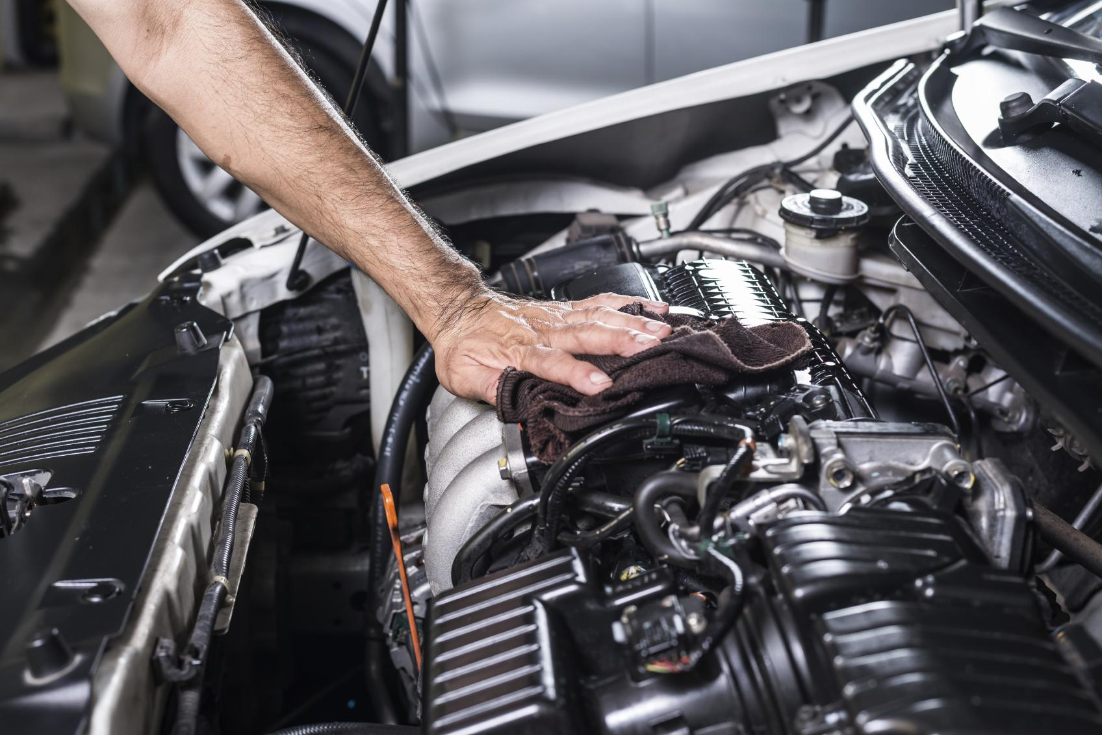

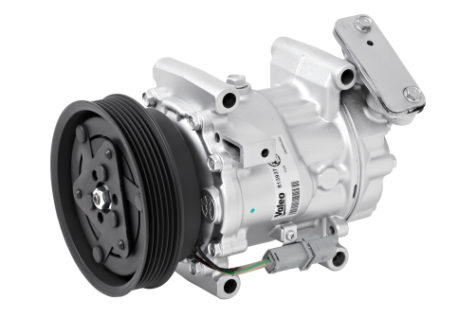
GREEN
TECH
AIR CONDITIONING
COMPRESSORS
More eco-friendly solutions to protect the planet while providing best-in-class quality

Slide 2

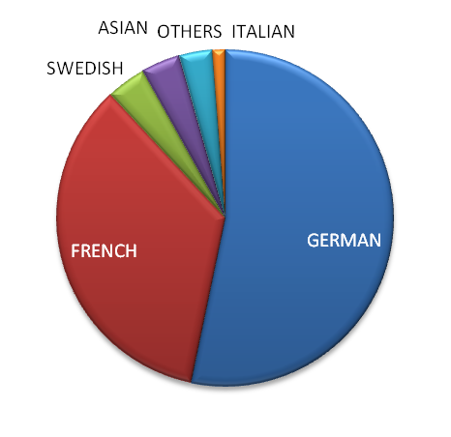
Triple Offer
New
70% coverage (EU)
*+6pts coverage in New
Remanufactured
61% coverage (EU)
TM-Series (Universal)
COMPRESSORS
530 P/N
already available
+60 P/N*
Available before end of Q1 2019
+25%
sales growth in 2018
Share of Valeo sales per car manufacturer origin
Notes:
Why is Valeo a legitimate player for the aftermarket solution in this range?
Legitimacy via technology or beacause leader or because OE adquisitions
Market share OE or growth OE
Innovation OE/IAM
Quality references (awards)
Integration in Valeo Group strategy (smart, green solutions...)
Product regognition IAM or OE

Slide 3
COMPRESSORS OFFER
LEGITIMATE POSITIONING
Innovation leader in
Eco-friendly Thermal Systems

Slide 4


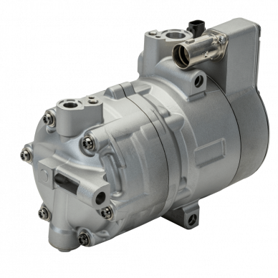

60 years of O.E. Expertise in Thermal Systems
COMPRESSORS
INNOVATION
Electrically Driven Compressor
Adapted to Hybrid and Electric Vehicles
O.E. partner of all major car manufacturers in
Europe, Asia & America
Leading Developer
& Manufacturer of Bus A/C Systems
Notes:
Why is Valeo a legitimate player for the aftermarket solution in this range?
Legitimacy via technology or beacause leader or because OE adquisitions
Market share OE or growth OE
Innovation OE/IAM
Quality references (awards)
Integration in Valeo Group strategy (smart, green solutions...)
Product regognition IAM or OE

Slide 5
COMPRESSORS OFFER
WHY CHOOSE VALEO?
A Dual-Offer perfectly adapted to distributor and workshop needs

Slide 6
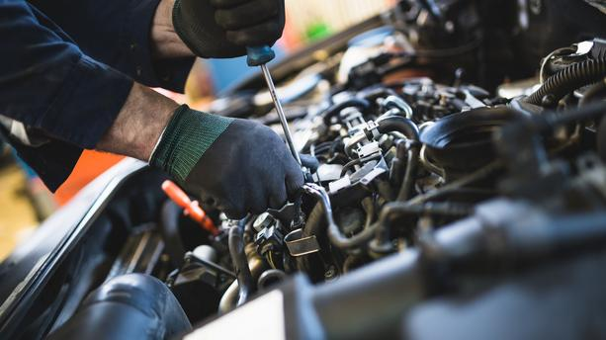


Competitive
New/Reman
Dual-Offer
COMPRESSORS
GROWING MARKET
260 MILLION
vehicles equipped with A/C in Europe
Best-in-Class Quality
both in New and Remanufactured
Ranges
(OE know-how)
Tech’Care
Experts and Advanced Hotline
Notes:
Why is Valeo a legitimate player for the aftermarket solution in this range?
Legitimacy via technology or beacause leader or because OE adquisitions
Market share OE or growth OE
Innovation OE/IAM
Quality references (awards)
Integration in Valeo Group strategy (smart, green solutions...)
Product regognition IAM or OE

Slide 7
COMPRESSORS OFFER
GROWTH OPPORTUNITIES
Develop your business in the most simple way: with Valeo Service

Slide 8



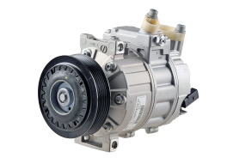
z
THE ESSENTIALS
CHOOSE THE RIGHT CARDS
NEW CARDS
MAKE A DIFFERENCE WITH VALEO
VALEO REF | MAIN APPLICATIONS |  | EU CAR PARC
699357 | VW GROUP | AUDI A3 - SEAT Leon II - SKODA Octavia - VW Golf V, Passat, Touran | 17 261 063
813157 | MERCEDES | MERCEDES C Class (204) (2007>) et Sprinter | 976 777
813200 | VW GROUP | AUDI A3, TT - FORD Galaxy - SEAT Alhambra, Cordoba, Ibiza, Toledo - VW Bora, Golf IV, New Beetle, Sharan | 3 379 392
813256 | DACIA | Logan (X90, H79), Lodgy (J92) | 802 429
813144 | RENAULT | RENAULT Trafic (2001>) | 801 565
813140 | VOLVO | VOLVO S80, V70 (2000>), XC90 | 376 797
699393 | PSA | CITROEN C1 - PEUGEOT 107 - TOYOTA Aygo | 2 170 342
813323 | FORD VOLVO | VOLVO S40, V50,C70, C30 FORD Focus II | 1 642 758
813113 | NISSAN | NISSAN Micra (K12), Note | 425 109
813147 | RENAULT | RENAULT Laguna III (2007>) | 106 069
Range of new compressors growing by more than 100 parts in the current year
European fast movers, all technologies
Asian O.E. Parts produced by Valeo in Thailand and China
VALEO REF | MAIN APPLICATIONS |  | EU CAR PARC
813299 | HONDA | HONDA Civic VIII | 346 972
813193 | FORD | FORD Fiesta VI | 499 693
813280 | FORD | FORD Tourneo, Transit (2006) | 264 214
813118 | HONDA | HONDA Civic VIII | 121 132
813281 | SUZUKI | SUZUKI SX4 (2006) | 189 776
813119 | HONDA | HONDA Civic VIII | 162 398

Slide 9

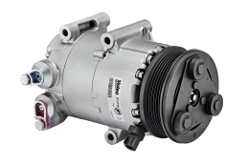
z
THE ESSENTIALS
CHOOSE THE RIGHT CARDS
NEW CARDS
MAKE A DIFFERENCE WITH VALEO
VALEO REF | MAIN APPLICATIONS |  | EU CAR PARC
699857 | VW GROUP | AUDI A3 - SEAT Leon II - SKODA Octavia - VW Golf V, Passat, Touran | 17 261 063
813700 | VW GROUP | AUDI A3, TT - FORD Galaxy - SEAT Alhambra, Cordoba, Ibiza, Toledo - VW Bora, Golf IV, New Beetle, Sharan | 3 379 392
699862 | OPEL | OPEL Astra G (98>) | 1 206 199
813723 | PSA | Citroen C4, Berlingo, PEUGEOT 207, 307, 308, Partner, Teepee | 3 493 642
699746 | RENAULT | RENAULT Megane (98>) | 1 244 247
813838 | AUDI | AUDI A3 | 6 128 888
813657 | MERCEDES | MERCEDES C Class (204) | 1 012 974
813662 | PSA | CITROEN C4, C4 Picasso, PEUGEOT 307 | 1 550 244
813602 | OPEL | OPEL Astra H (2004>) | 581 657
699770 | OPEL | OPEL Astra G (98>) | 1 136 775
Range of remanufactured compressors growing essentially on European fast moving vehicles
Double range to offer competitive solutions
Remanufactured in Europe
VALEO REF | MAIN APPLICATIONS |  | EU CAR PARC
699884 | VW GROUP | VW Polo | 4 713 286
699885 | VW GROUP | VW Polo | 2 477 773
813823 | FORD | FORD Focus II, C-Max | 1 208 348
813883 | RENAULT | RENAULT Clio 4 1.5 DCI | 651 867
813882 | RENAULT | RENAULT Clio 4 0.9 / 1.2 | 434 311
813660 | OPEL | OPEL Astra, Meriva | 376 660

